Slide 1
Lab 9 and 10: Operating Characteristics of JFETs
EE316-08 Spring 2021

Slide 2
Purpose: The concept of the junction field effect transistor (JFET) is introduced. Understanding the configuration and states of JFETs will aid in the understanding of MOSFETs which will be introduced in later labs. Both NPN and PNP constructions are considered. Constants and variables relating to JFETs are discussed and utilized to convey a full understanding of the material. JFETs have high input impedance and low output noise. These features make JFETs ideal for small signal amplification. Unlike BJTs current can flow from drain to source or vice versa equally.

Slide 3
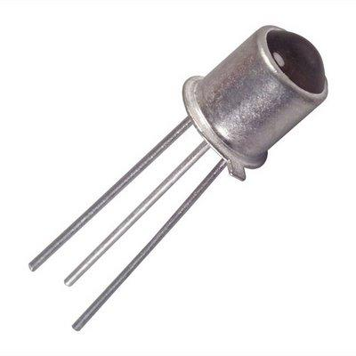
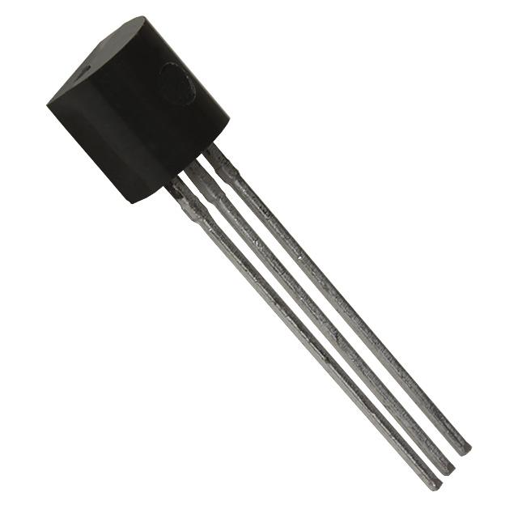


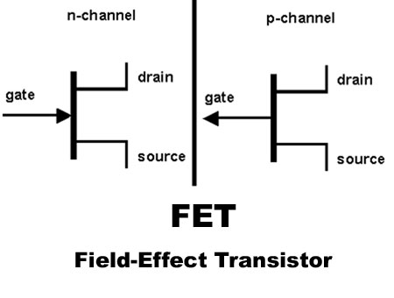
Recall Transistors Background
Transistor is a semiconductor device used as amplifier control or electrically controlled switch.
Transistors can be found in switching circuits, amplifier circuits, and voltage-regulator circuits.
Two basic types of transistors are bipolar junction transistors (BJTs) and field-effect transistors (FETs).
The main difference between BJTs and FETs is that BJTs are current-controlled while FETs are voltage-controlled.
Physical and symbolic representation of BJTs
Symbolic representation of FETs

Slide 4
Junction Field-Effect Transistors (JFETs)
JFETs are used to electrically control switches, voltage-controlled resistors, and amplifier controls.
JFETs are three-lead semiconductor devices with gate (G), drain (D), and source (S).
There are two types of JFETs, n-channel or p-channel.
Symbolic representation of JFETs

Slide 5
Junction Field-Effect Transistors (JFETs)
For n-channel JFET, current flows into the channel region at the drain side and comes out at the source side.
A negative voltage applied at the gate side reduces current flow from drain to source.
For p-channel JFET, current flows into the channel region at the source side and comes out at the drain side.
A positive voltage applied at the gate side reduces current flow from source to drain.

Slide 6
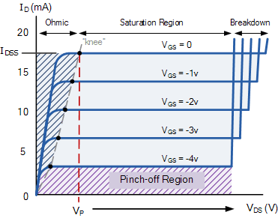
Operating States of JFETs
Ohmic (linear)
JFET behaves like a voltage-controlled resistor
Saturation
The drain current is strongly influenced by gate-source voltage but not influenced by drain-source voltage
Pinch-off
JFET acts like open circuit
No current flowing through the device
Breakdown
JFET loses ability to resist current because too much voltage applied across the drain-source terminals
4.
1.
2.
3.

Slide 7
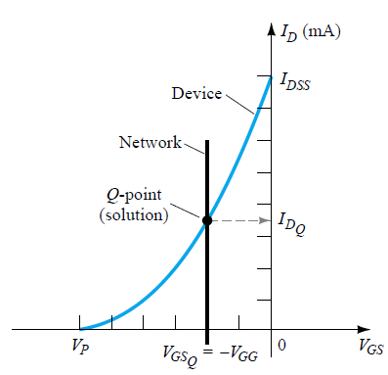
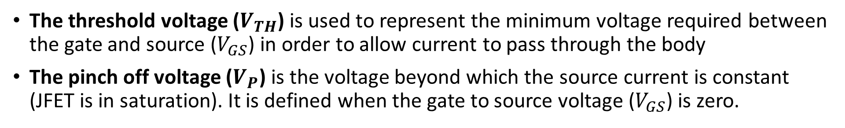
Output characteristic V-I curves of a typical JFET
Drain Characteristics
Transfer Characteristics
The threshold voltage ($V_{TH}$) is used to represent the minimum voltage required between the gate and source ($V_{GS}$) in order to allow current to pass through the body
The pinch off voltage ($V_{P}$) is the voltage beyond which the source current is constant (JFET is in saturation). It is defined when the gate to source voltage ($V_{GS}$) is zero.

Slide 8
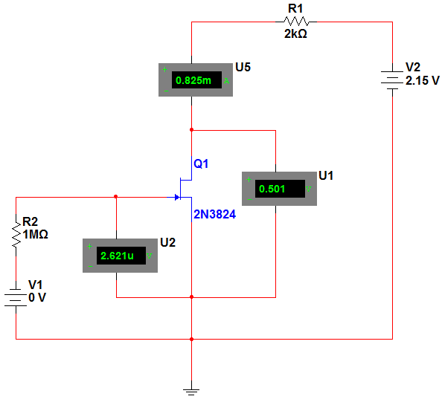






Figure 9.4
$$I_{D}$$
$$V_{D}$$
Drain
$$V_{DS}$$
Gate
$$V_{G}$$
$$V_{GS}$$
$$V_{S}$$
Source

Slide 9
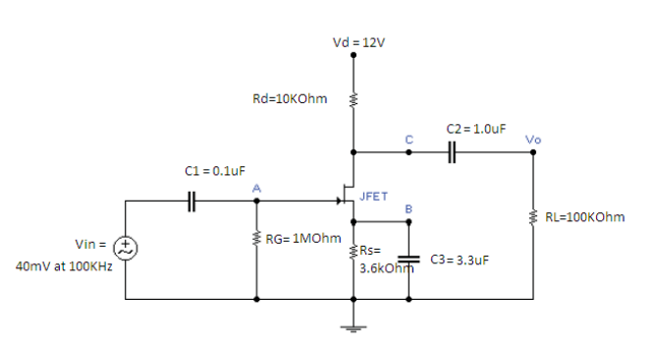
Figure 10.1

Slide 10



Gain, Low and High Cutoff Frequencies, and Bandwidth
Frequency (Hz) | Vout (mV) | Gain
30
45
60
100
200
500
1000
10000 (10 kHz)
100000 (100 kHz)
500000
1000000 (1MHz)
1500000
2000000
3000000
4000000
5000000
7000000
10000000 (10MHz)
11000000
12000000
15000000
16000000
19
3 dB
16
Bandwidth
7
4
$f_{L}$~ 10 Hz
$f_{H}$~ 10M
Therefore, Bandwidth = $f_{H}$- $f_{L}$

Slide 11
Summary
Lab 9 and 10 Report is due Tuesday 6th April 2021 by midnight.
Prelab 11 and 12 is due Tuesday 13th April 2021 by midnight.
Fill out Table 9.1, 9.2 and 10.1 with results from…
Simulation
Experimental results

Slide 12
Reference
Electronic Devices and Circuit Theory, 7th Ed. by Robert Boylestad and Louis Nashelsky.

